Slide 1
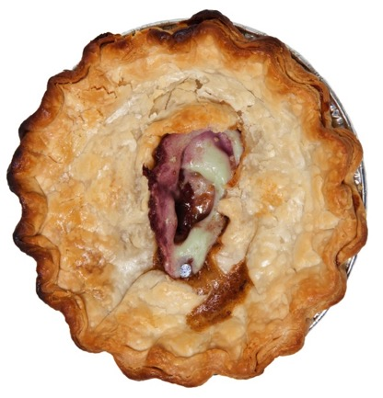
Contact: Clarissa Jacobson – 323.394.0078 clarissajaye@gmail.com
www.lunchladiesmovie.com For Distribution Enquiries
Contact: Ouat Media - 416.979.7380
info@ouatmedia.com
Duration: 18:51 Minutes
Aspect Ratio: 2:39 (Scope)
Shooting Format: Arri Alexa 3.2k
B/W Color: Color
Country of Production: USA
Year of Production: 2017

Slide 2
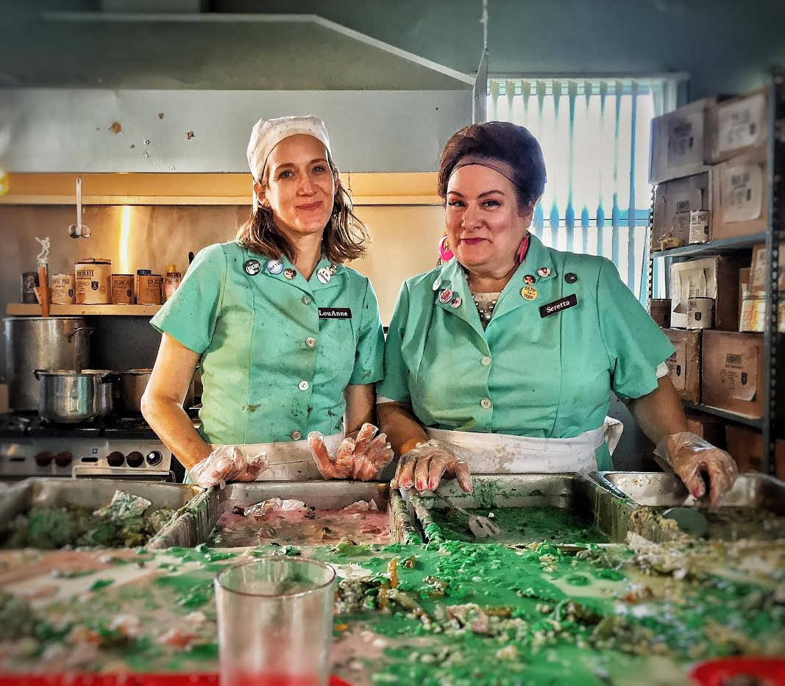
Lunch Ladies

Slide 3
Synopsis
For the past twenty years, obsessed Johnny Depp fans and fraternal twin sisters, Seretta and LouAnne Burr, have shared a miserable existence as high school Lunch Ladies serving up rubbery chicken parts, ammonia-treated government meat and whatever else the cash-strapped national lunch program sends their way.
This year is going to be different: The twin’s Cheesy Burger Bites recipe is the Grand Prize Winner of Johnny Depp's Cook for Kid's Charity Event!
Convinced this is their ticket out of high school hell town and that “The Depper” will hire them to be his very own Personal Chefs, their dreams are shattered after a snotty head cheerleader pushes them one step too far.
This forces the Lunch Ladies to ask themselves…
WWJD? What would Johnny do?

Slide 4
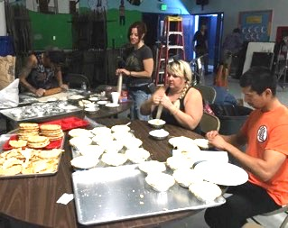
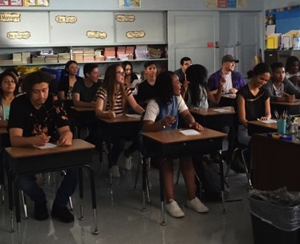
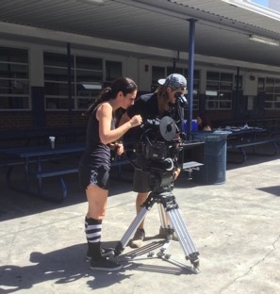
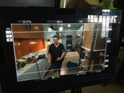
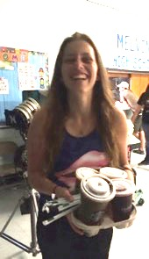
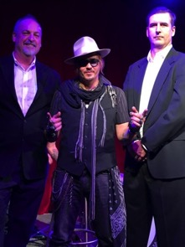
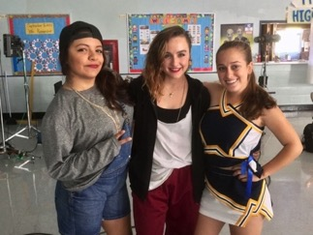
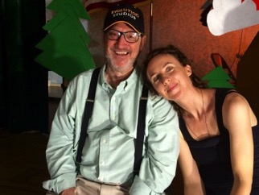
Cast & Crew Bios

Slide 5
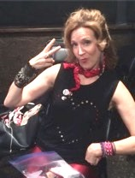
Cast
Lunch Ladies
DONNA PIERONI – Seretta Burr
Donna Pieroni has busted her ass for the last twenty-five years and her career is finally starting to take off! She has over one hundred credits on IMDb and has worked with the likes of Jessica Lange, Ben Affleck and Viola Davis, to name a few. Donna studied at Second City and Columbia College of Chicago, as well as Illinois State University. After graduating Illinois, she booked a contract with Disney MGM Studios in Florida where she was discovered by an agent. She ended up being cast in Edward Scissorhands (with a very young Johnny Depp) which got her a SAG card and off she was to Los Angeles. Her career more or less began with Johnny Depp so this film is quite dear to her!
MARY MANOFSKY – LouAnne Burr
Mary Manofsky was a Sunday Company member of Los Angeles’ renowned improv comedy troupe, The Groundlings, where she got her start working alongside Will Forte, Chris Parnell, and Cheryl Hines. She recently appeared on Criminal Minds and the HULU original series Future Man. Mary can also be seen in the films The Garage Sale, directed by J.M. Logan, and Rumor From Ground Control. Originally from Ohio, she graduated from Ohio State and currently lives in Osaka, Japan with her husband, two children and dog, Lucy.

Slide 6
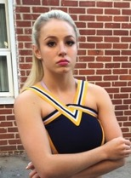
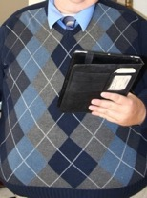
Lunch Ladies
DAISY KERSHAW – Alexis
Newbie actress, Daisy Kershaw is a Level Five Cheerleader, an avid rapper and prolific writer who makes her own movies. At the ripe old age of sixteen, Lunch Ladies became her first supporting role. Daisy currently attends Santa Barbara College proving she not only has talent and beauty, but brains too.
CHRIS FICKLEY – Principal Grossfetig
Chris Fickley, our faceless Principal, is a small town boy, taking the midnight train going anywhere. He has spent years writing, producing, directing, teaching, and acting in the occasional role when his life is threatened. He enjoys long walks on the beach, piña coladas and getting caught in the rain. He directed the feature film Gunfight at La Mesa and is currently searching couch cushions for loose change.

Slide 7
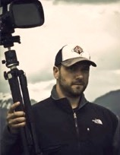
Crew
Lunch Ladies
CLARISSA JACOBSON – Writer/Producer
Originally from Minnesota, Clarissa Jacobson is from the only family in the state that isn’t Norwegian and didn’t eat Tater Tot hot dish every Sunday. Clarissa started out as an actress, has a BA in theatre from Indiana University and trained at The American Musical and Dramatic Academy in New York City. She went on to perform off-Broadway and in numerous film and voice over roles before realizing her true passion was writing. A long-standing member of Twin Bridges Writing Salon, she thrives on creating kick ass female characters and has several scripts under her belt including the full-length version of Lunch Ladies. Her feature screenplay, Stella By Starlight, has been optioned by Beverly Nero Productions and Norman Stephens Films. Clarissa happily resides in Los Angeles with all the other weirdoes.
JM LOGAN – Director/Producer
JM is an award-winning filmmaker and cinematographer who has lived many lives in the film industry. Starting in makeup effects building big rubber monsters and slinging blood on movies like The Dentist, Wishmaster 2, and Texas Chainsaw Massacre, he transitioned through visual effects, sound design, composing and supervising post production for the studios. He now wears diverse hats as a multi-faceted filmmaker directing, shooting, producing and editing. In addition to directing Lunch Ladies, his recent projects include an interactive feature film The Garage Sale, producing a feature documentary The Disunited States of America for Sky TV and Manson Family Vacation for the Duplass Brothers. He is currently completing the pilot for a new anthology series CTRL|ESC.

Slide 8
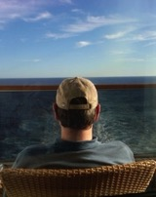
Lunch Ladies
JOE BRATCHER – Producer/Head Choreographer
Joe Bratcher seems to reinvent himself every seven to fourteen years. Retrieving various incarnations from his 45 year adventure:
After graduating Northwestern University, Joe was an actor in Broadway musicals, television and film, a writer of movies, episodics, and books, a screenwriting teacher at UCLA Ext. Writer’s Program for eight years, creator of the first beginning screenwriting on-line course for UCLA, artistic mentor to many including the trifecta producing team on Lunch Ladies – Clarissa, Shayna and Jessica - owner (with wife Judy Farrell) of Twin Bridges Screenwriting Salon – 28 years and counting, literary manager and producer… but always always always… at heart… a tap dancer. (Still taps three hours a week.)
SHAYNA WEBER – Producer
Shayna Weber grew up in Bend, Oregon and attended Oregon State University before moving to Los Angeles to pursue a career in the entertainment industry. In addition to producing, Shayna is a screenwriter who focuses on female-driven projects and plans to start a production company. Shayna has also been a producer of reality programming for the past fifteen years for network, cable and online channels for the hit shows So You Think You Can Dance, Brew Dogs, and RuPaul's Drag Race among others. She is a long standing member of Twin Bridges Screenwriting Salon and resides in Los Angeles with her husband and new baby.

Slide 9
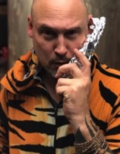
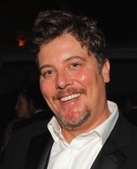
Lunch Ladies
MATT FALLETTA – Executive Producer/Special Effects Supervisor
Matthew Falletta grew up in North Carolina and attended The North Carolina School of the Arts to study acting, mime and dance and Columbia College in Chicago. In NC he helped create East Coast Stunts at Screen Gems Studios in Wilmington as well as opening a special effects shop working on productions like One Tree Hill and Virus. Today Matt resides in Los Angeles and is the co-owner of SOTA F/X which has been in business for well over 20 years.
*We are pleased to have obtained Matt through the Los Angeles Prison System on a work release program. He has been cleared of all charges against him and is looking forward to reintegrating himself into society as a rodeo clown. Matt continues to maintain that "the swarm of dried leaves came at me with obvious malice and I simply did what had to be done."
CHRIS EKSTEIN – Director of Photography
Chris Ekstein graduated from NYU Tisch School of the Arts and received his MFA from AFI, where his 35mm thesis received the prestigious Alfred P. Sloan Grant. He is also the recipient of the Panavision New Film Maker Award. In 2010, Chris won best cinematography at the American International Film Festival and was the cinematographer on the features Mexican Sunrise (Gold Award-WorldFest) and Callous (Best Picture-IndieFest). Chris is a founding partner of Market Street Productions and the father of two girls who lent us their one-eyed hamster, Smarty, for our classroom scene.

Slide 10
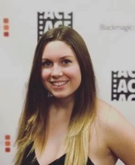
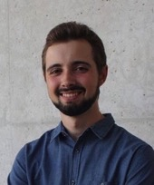
Lunch Ladies
AMELIA ALLWARDEN – Editor
Amelia Allwarden grew up between two horse farms in New Hampshire, and worked on a blueberry farm as a teenager. Never wanting to be anything other than an editor, she moved to Los Angeles and interned with American Cinema Editors, where she learned the craft of editing in depth. Reading the Harry Potter books as a kid made her want to pursue a career in story telling. She still believes in magic, probably because editing IS magic.
ANTONI M. MARCH – Composer
At age 7, Antoni M. March won his first prize for a composition. At 14, he wrote and copyrighted an opera for symphony orchestra, choir and vocal soloists. Today he is one of the youngest composers to have conducted and recorded his own music with a 67-piece symphony orchestra at the Eastwood Scoring Stage/Warner Bros. Studios. A recent graduate of the Royal Conservatory of Madrid, Antoni has composed over seventy works with more than thirty of them performed in cities such as Los Angeles, London, Paris, Stockholm, Madrid and Milan. Awarded a Fulbright Scholarship for arts studies, he will be attending USC for their “Screen Scoring” Program.

Slide 11
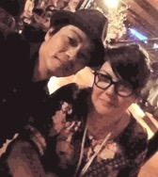
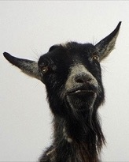
Lunch Ladies
RAY & ALICIA HO – Production Designers
Husband and wife team, Ray and Alicia Ho have done production design and set dressing for film, TV, various music videos and theatre. In addition, Ray is a bitchin’ tattoo artist and builder boy wonder while Alicia has a background in Interior design, Art History and is fierce with a sewing machine. A force to be reckoned with, Ray and Alicia were hired one week before filming, and were able to transform the Lunch Ladies’ empty kitchen into a huge crazy mess, complete with amazing homemade stenciled food cans and boxes (see photo to left) and an overkill of Johnny Depp memorabilia.
ERIC RAGAN – Line Producer
Eric Ragan is a freelance producer, director, editor, writer and is a graduate of Los Angeles Film School. Eric specializes in working on new, non-traditional and innovative projects for television, film, and the web. His current feature film project, Scumbag, won Best Ensemble Narrative Feature at Queen’s World Film Festival 2017. Eric was a calming force throughout the production and his Burning Man photos he shared on set were super sweet.

Slide 12
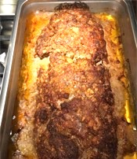
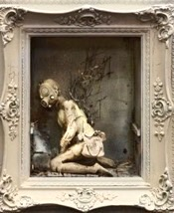
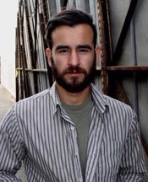
Lunch Ladies
SUSAN BOYLE – Food Stylist
Susan Boyle put hours upon hours of work and creativity into her sick and unsavory creations: chocolate “diarrhea” pudding, pies upon pies, chunky cheerleader stew, limp green beans, meatloaf gristle (see side photo), and painstakingly handcrafted “beef turds” designed to soar effortlessly through the air at the Lunch Ladies. Susan is also a registered RN – which helped us breathe easy on set with the vomit-worthy food that was served up.
KRYSTOPHER SAPP – Artist who Created T-Rex The Meat Grinder
Krystopher Sapp loves to stay locked up in his studio creating dark and twisted worlds in the form of mixed media assemblage. Inspired by his favorite horror and sci-fi movies, war history books and intense nightmares his works are cultivated from fear and molded into beauty. He uses found objects and items purchased at Home Depot – the place he calls his art supply store. By day, Sapp is a commercial artist and has created album cover, t-shirt and poster art for bands such as Demented Are Go, Meteors, Necromantics, Penis Flytrap, Zombie Ghost Train and many others. www.krystophersappart.com
DESMOND EVAN SMITH – Costumer
Desmond Evan Smith is a costume designer, stylist, art director and scenic artist based in Los Angeles. Desmond excels in detail, which can be seen right down to the mildewed food stains he lovingly painted on LouAnne’s hideous comfort support orthotic plastic kitchen clogs. He has a degree in art history and a background in fine art painting, custom clothing construction and tailoring. He's worked on numerous productions for clients and artists including Bruno Mars, Demi Lovato, Britney Spears, Chris Brown, Big Sean, YouTube, Apple, Toyota, Ford, Fiat, Chanel, Vanity Fair, Young the Giant, and even UFC wrestlers.

Slide 13
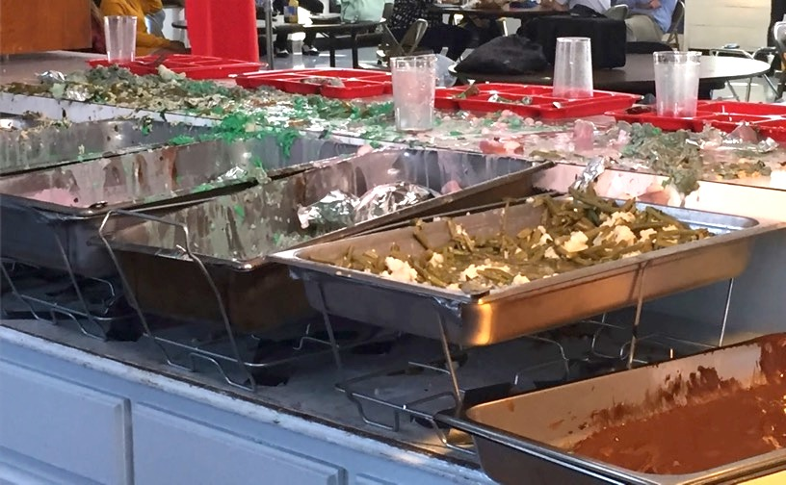
Lunch Ladies
What’s for lunch? Not that again.

Slide 14
Q&A with Writer & Producer Clarissa Jacobson
You’re kind of sick. Where did you come up with the twisted idea for the film?
I was out to dinner with Donna Pieroni (cast as Seretta) who was lamenting about another actress friend of hers, who because they are similar types, are always in competition. She said she wished there was a movie with two lunch ladies as leads because then they could be cast together.
A spoof on Sweeney Todd immediately popped into my head because it’s my favorite musical and everyone bitches about school lunches. I could see two fraternal twin lunch ladies working in the same dismal high school, being treated poorly by everyone. My father was a high school teacher so I had a pretty good foundation of the crap faculty has to put up with. I could see them snapping, killing a snotty cheerleader and serving her up for lunch.
The Lunch Ladies’ obsession with Johnny Depp naturally followed because Johnny had starred in the movie version of Sweeney Todd and I loved the idea of two fanatical lunch ladies who escape their day to day reality by fantasizing about “The Depper.” They could further blame the idea of baking up a snotty cheerleader on him because “he” had done it in Sweeney Todd. That’s where the acronym “WWJD” came from:
“What Would Johnny Do?”
After I finished the feature (which took eighteen months to write), I was meditating and the thought of making a short out of it as a proof of concept came to me. That took another FIVE months to write.
I had never produced anything before and had I known how incredibly hard this would be with food, special effects, difficult location and giant cast, I probably would’ve balked.
There’s something to be said for being ignorant.

Slide 15
Lunch Ladies
What was your vision?
Lunch Ladies is a story about underdogs, friendship and going for one’s dreams. It’s positive even though it’s dark and twisted. To bring that vision to life I wanted it bright and silly so you feel good even though the story is disturbing as hell. I wanted a world with big cartoonish colors - like a comic book - and I wanted it stylized with every moment being specific – a heightened reality. I wanted controlled chaos and it needed to be surreal with touches of insanity - like sparks flying from the cord when the meat grinder is plugged in, the pot pies at the end to have a glow that you can barely see and crazy props like a guy playing a trumpet in the middle of the lunch room.
The director and I were on the same page from the very beginning.
Originally my vision for the location was one of a John Hughes school – elite and high-end with sparkling appliances and bright hallways. When we couldn’t get the school I wanted, we had to rethink it. There was no way we could bend the new location to look like what was in our minds – the school had a ton of personality but did not look elite or high-end and it would be impossible to make it look that way on my budget. So, the director, JM Logan, came up with a great way to keep the surreal and over the top vibe alive. He said:
“Embracing the 1940s style and technology of our location transformed the Lunch Ladies’ school into an oppressive regime. I put together photos from the cold war and found a new fascination with the art, color, texture and shapes of the Eastern Bloc. This then allowed the art department to enhance what was already present in the location which made things tremendously easier. They made propaganda posters, built a crummy, ragged kitchen, and turned it into as much of a nightmare as they possibly could!
The Soviet textures then lead to my listening to a lot of Eastern European classical music while doing my blocking charts and shot lists, which of course included Prokofiev, which I gave to Joe Bratcher, the choreographer who had the idea of creating a dance number out of the crazy lunchroom scene, which was one of the coolest things we did in the movie. The domineering music in that spot gave it a whole different feel and worked great.”

Slide 16
Lunch Ladies
How did you find director, JM Logan?
The original director I had on board backed out after several months of dragging his feet getting started. I was devastated. I still remember sobbing on the phone, telling my mentor Joe Bratcher (producer/head choreographer) and my close friend Shayna Weber (producer) that I didn’t know what to do or where to find someone as good. He said he couldn’t do it because: 1) no one wanted to see two middle-aged women on screen, 2) that I would never find a school that would let us film, 3) that the special effects would never look good enough, 4) that I wouldn’t find anyone to design the giant meat grinder, 5) that I would never get enough extras to cast in the scenes, 6) that no professional actresses or crew would want to be part of it 7) that no one would want to score it and, 8) that I should find a student director because a working director would never do it.
Joe and Shayna promptly told me that was bullshit.
With that, I wiped away my tears, put on my big girl panties and mass emailed all my contacts on LinkedIn (this was the first time I’d ever used the site for anything except to collect names). I got two recommendations from people I hadn’t talked to in ages – Matt Falletta (who ended up being the executive producer/special effects supervisor) who I had met at a bar three years ago, and Gregg Daniels (Rainstorm Entertainment) who had optioned a script of mine a few years back.
Both of them recommended someone they called a genius. What was amazing is they didn’t know one another but they both suggested the same person – JM Logan!
The minute I met JM I knew he was the one - we were on the same page artistically, had a million great ideas, was easy to work with, believed in the piece, was excited to do it, had great contacts and best of all he was a “we can do it!” guy.
An interesting side note - there was another short I had written after Lunch Ladies based on the first director’s advice that no one wanted to see middle-aged women as leads. JM insisted on doing Lunch Ladies.

Slide 17
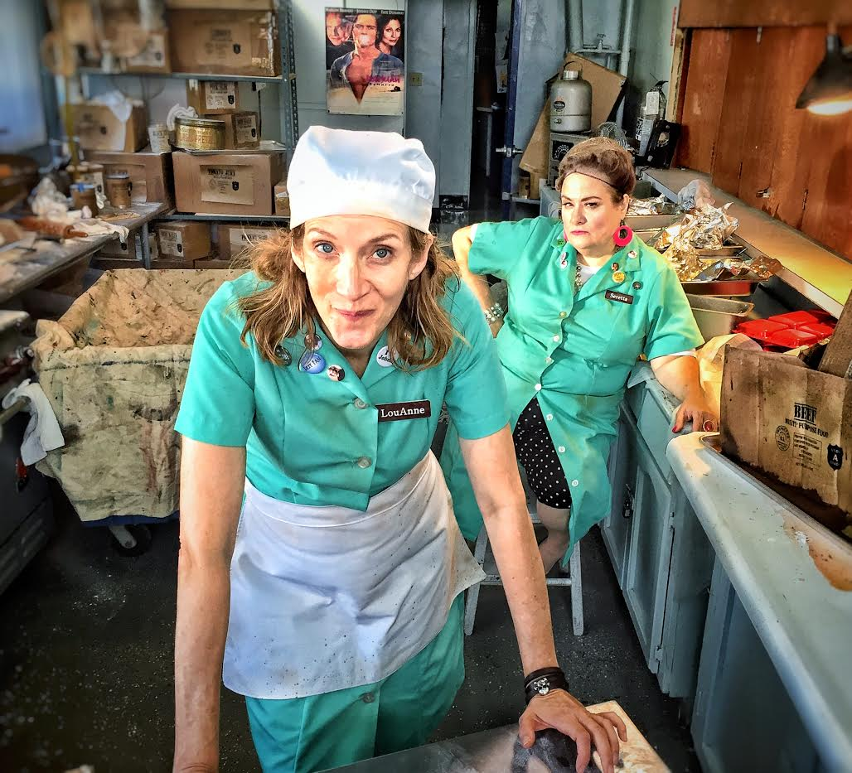
Lunch Ladies
That snotty cheerleader really pissed us off.

Slide 18
Lunch Ladies
What was the most difficult scene in the movie to shoot?
The lunchroom sequence where kids are dumping their trays.
Not only did it require a significant amount of actors (we ended up with forty extras), but we only had a few hours to film it due to time constraints on the space. Further, since there was no money in the budget to pay all these people, I had done all the casting online “NO PAY CREDIT ONLY” and I didn’t know how many were going to show up the day of the shoot or the quality of performers I would get. I also had no costume budget for them so JM cast them in cliques – Goths, nerds, rockers, jocks… and we asked them to bring their own wardrobe. Our main worries were that we wouldn’t have enough extras show up, the lunchroom would be empty, we would run out of time trying to get it right, and costumes would be all wrong.
To make it even more ambitious, we didn’t know what the dance mosh was going to look like or how it was going to fit together with the extras. Head choreographer and leader of the tap section, Joe Bratcher had been working for months with the other choreographers, Rebecca Ruschell for ballet and Monika Felice Smith for hip hop. But none of the dancers knew the sequence and only had one hour before the shoot to get it down. We were confident they could learn it, we had cast great folks, but we didn’t know how it would all look together or if the extras playing the students would mesh. It could very well have been a huge mess.
Not only did almost every single extra show up that I had cast, but they were dressed perfectly and were all talented and professional performers. They nailed it! When it all came to together no one could believe their eyes. I was hiding out trying not to be in the way but if I’m honest it was because I was so nervous. Estelle Matranga, the production coordinator came and got me ten minutes into shooting and told me I had to come and see it. “It’s brilliant.” I didn’t believe her at first. She’s French.
It turned out exactly as we had imagined - High School Musical on crack.

Slide 19
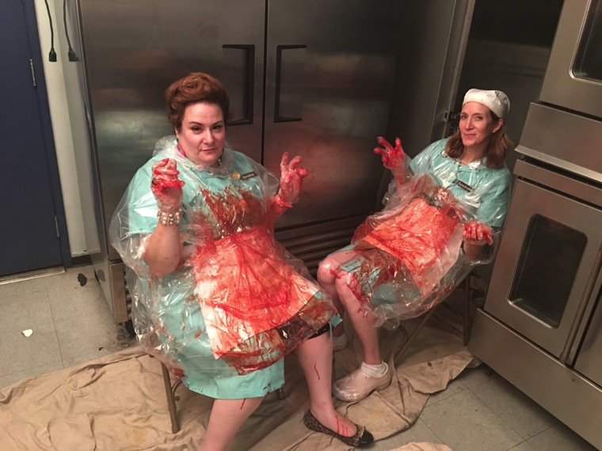
Lunch Ladies
Anyone hungry?

Slide 20
Lunch Ladies
What was the most magical thing that happened during the production?
I feel like Lunch Ladies had a lot of magic behind it. So many little things happened that I thought were problems which ended up being blessings. It was almost like everything was aligning to bring the best possible situation into play. As mentioned, the first magical thing that happened was losing the original director and replacing him with JM. Next up was finding the location. I must’ve called more than a hundred schools. We finally got a taker – Lancaster High School. Then the Superintendent backed out when he read the content. (“Inappropriate” my ass!) We ended up getting a Catholic school (how funny is that?) which was a hundred times better than Lancaster. It had so much character, they were thrilled to have us and the principal was amazing – she was totally in our corner helping and watching out for us.
Other magical things - our production designer quit one week before the shoot and we replaced them with husband and wife team, Alicia and Ray Ho. They worked 24/7 and made the set better than anything we could imagine. More magic - neither of the two lead actresses auditioned for the roles. I cast Donna but had never seen Mary act, JM cast Mary but he had never seen Donna act. We just trusted one another. Donna and Mary were perfect together. Then there was the fact that we had no idea how we were going to find, much less afford, a giant meat grinder. Abracadabra, I stumbled across artist, Krystopher Sapp’s amazing work at La Luz Gallery in Los Angeles. I messaged him on Instagram. He messaged me back, and the rest is history. He made the most awesome and surreal creature with limited funds and unlimited imagination. Then there’s the score… the wonderful score that Antoni M. March composed - but imagine when I found out that JM, Antoni, Federico Jusid (music producer) and María Ulled (music production manager) arranged for a 60 piece orchestra in Hungary (The Budapest Art Orchestra) to record and play it for us?!
I suppose the most magical thing about the movie, however, happened to Ray and Alicia. They had been trying to have a baby forever and conceived during filming! Alicia called it:
“Who knew fake blood, Johnny Depp and gross cafeteria food was a baby making formula?”

Slide 21
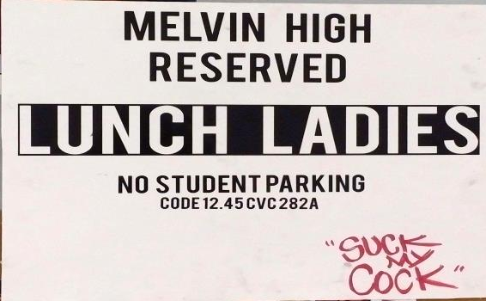
Tasty Facts
Lunch Ladies
We used 10 gallons of blood, 10 gallons of slime/goo, 15 gallons of “food,” 40 pounds of potatoes (200 pounds brought to set) and 13 pounds of ground meat.
48 pie tops were made of salt dough and varnished, a hot glue gun was used to attach the tops to pie tins. 25-30 real pies were made. 20 pounds of flour was used and the meatloaf was made from cheap very fatty ground beef, SpaghettiOs and Saltine Crackers - a big loaf of greasy gristle with wormy looking bits – yummy!
We prepped the film for four months and filmed over the course of two weekends in South Central Los Angeles.
Our first catered meal was awful – we had to fire the real lunch ladies on the Lunch Ladies’ set.
Shayna Weber, our producer, gave birth to her son, Max Bowie Band, two weeks before we filmed.
We had a diverse cast and crew which included African Americans, Asians, Hispanics, Caucasians, a French production coordinator, Spanish composer, music producer and music manager, an orchestra in Budapest and handicapped actor/screenwriter Kent Rodricks who was one of the first successful spinal fusion surgeries in the world. (Kent told me to put this in.)
Our final horror scene went way over schedule and we finished cleaning up gallons of fake blood only one hour before kids were to arrive for Monday morning school.
The fake decapitated leg that Seretta holds up in the T-Rex Meat Grinder scene is a cast of Clarissa’s. The fake ear in the pie is a cast of Matt Falletta’s.
After the shoot, Clarissa hung up the Lunch Ladies’ parking sign in the parking spot at her apartment.
The landlord made her take it down.

Slide 22
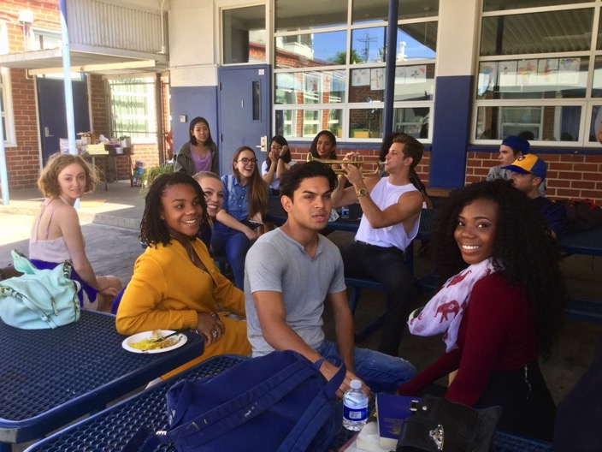
Lunch Ladies
That was the best lunch ever!

Slide 23
Crew Credits
Lunch Ladies
Writer Director Producers Executive Producer Director of Photography Editor Music by Production Designers Line Producer Special Effects Food Stylist Costumer Makeup First Assistant Director Head & Tap Choreographer Ballet Choreographer Hip Hop Choreographer T-Rex The Meat Grinder designed by Production Coordinator Script Supervisor Location Sound Mixer Boom Operators Locations Management Key Grip Gaffers Best Boy Electric First Assistant Camera Steadicam B-Camera Operator DI Technician Grip |  | CLARISSA JACOBSON JM LOGAN CLARISSA JACOBSON JOE BRATCHER SHAYNA WEBER JESSICA JANOS J.M. LOGAN MATT FALLETTA CHRIS EKSTEIN AMELIA ALLWARDEN ANTONI M. MARCH RAY HO ALICIA HO ERIC RAGAN MATT FALLETTA/SOTA F/X SUSAN BOYLE DESMOND EVAN SMITH BOBBY GUO DEVON GOLD NICK C. JOHNSON JOE BRATCHER REBECCA RUSCHELL MONIKA FELICE SMITH KRYSTOPHER SAPP ESTELLE MATRANGA MARIANA MARCANO KIRBIE SEIS SARA BRAVO KEVIN JACKSON ARTURO RODRIGUEZ SCOTT DUVALL LEVI KAMINKOWITZ COLLIN LINDSEY JAMIE SUTOR JACKSON TODD PARKER RONAN MIKAEL LEVIN NICHOLAS M. PUETZ LUQI ZHAO DANIEL JAMES |  | Second Assistant Camera Lighting Technician Key P/A DI Colorist DI Producers Digital Intermediate by DI Executive Producer DI Editors DI Assistants DI Management Engineering DI Administration Supervising Sound Editor Re-Recording Mixer Post-Production Sound provided by Music Produced by Music Production Manager MIDI Programmer & Music Preparation Music Performed by Conductor Sound Engineer Recording Producer Company Pro Tools Score Editor Score Mixed by “Bury My Body” Written and Performed by Courtesy of Visual Effects Digital Compositor |  | NATHAN GIRARD ANDRES HERNANDEZ IAN AUSTIN ETHAN SCHWARTZ MARY OMEL FREDDY HERNANDEZ LIGHT IRON KATIE FELLION MATT BLACKSHEAR MANNY DUBÓN GRIFFITH DAVIES CHRISTOPHER ABDON BRANDON TROTTER MICHAEL CIONI PETER CIONI AMIT DAVÉ CHRIS PEARISO EDGAR FURSE ZACK HOWELL DANA BLUMBERG PAYTON VAN AMBURGH BRYCE MARRERO MALLORY OTT HANNAH JOYNER JENNIFER RAZON MATTHEW FESTLE PATRICK GIRAUDI VIRTUAL MIX FEDERICO JUSID MARÍA ULLED ÁLVARO GALINDO BUDAPEST ART ORCHESTRA PETER ILLENYI GÁBOR BUCZKÓ MIKLÓS LUKÁCS EAST CONNECTION MUSIC RECORDING CO. MANUEL PÁJARO JULIAN SLATER FIRE THE ANIMAL COUCH GUY RECORDS ROGER NALL/11:11 MEDIAWORKS BRANDON FLYTE

Slide 24
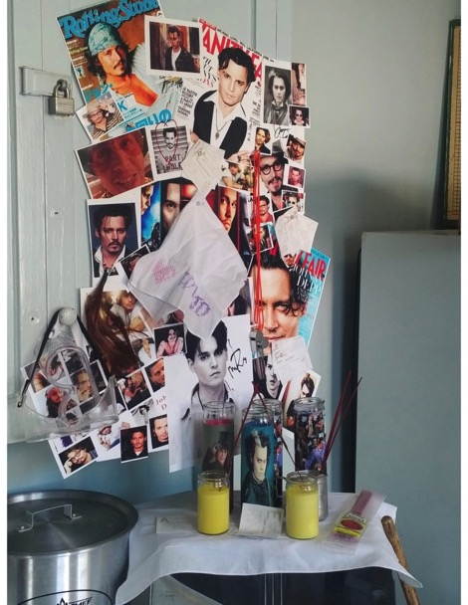
Lunch Ladies
Johnny Depp is always watching over us.

Slide 25
Cast Credits
Lunch Ladies
Seretta
DONNA PIERONI
Alexis
DAISY KERSHAW
LouAnne
MARY MANOFSKY
Principal Grossfetig
CHRIS FICKLEY
Crusty Janitor
RUDY HORNISH
Lunch Monitor
JOHN COMERFORD
Crock Pot Club President
EVE BUI
Jock Meatloaf Thrower
RYNE BENCKHART
Green Bean Moron
FIDEL QUIROZ
Ballet Dancers
AMI SHIMADA
KENDRA LEVY
JANICE LARAINE LUIS MARTINEZ
Hip Hop Dancers
ALEXA VELLANOWETH - Cheerleader
MONIKA FELICE SMITH
NOEL ARREOLA
Tap Dancers
ANI MARDEROSIAN
MICHAEL BRIAN
MATTHEW JAMES
Cheerleaders
MADISON WILLOW
VALERY DESMOND
Cool Kids
ADRIENNE ROBERSON
ISAIHA SOLIS
JONNY CARLO
Goths
EMMA BERGKVIST
HARLEY K. DELATORI
ISABELLE BRELU-BRELU
PAIGE AMICON
Jocks
KENYA DORSEY
Nerds
ASIA DORSEY
CAMRYN HOHNEKER
RYAN JONES
Princesses
KATIE HOWARD
KELLY ANNE DORAN
MIMI GAO
Rockers
ALISA BAGGIO
KIMBERLY FULMER
RISA ATA
Students
ESTELLE MATRANGA
GABRIELA RIOS-GARCIA
GENARO TORRES
IAN AUSTIN
JUAN CAMACHO
KEVIN VEGA
MANNY TRUJILLO
RUBEN MUNOZ
YVETTE XIMENEZ
Faculty
KELLY KEATON
KENT RODRICKS
ROBERT DESMOND
SHAWNA CHANCE
SUSAN MARYA BARONOFF – Poetry Teacher
TAMARA BERG
Bouncers
STEVEN BOTTOMLEY
STEVEN HAAS
Johnny’s Band
MELISSA MEDNICK
T.S. WATERS
Crowd
BEV NERO
CLARISSA JACOBSON
DANIEL JAMES
J.M. LOGAN
KAVY RATTANA
LUQI ZHAO

Slide 26
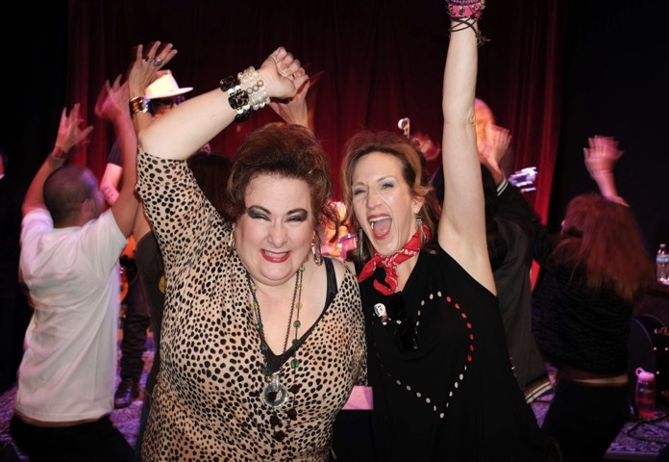
Lunch Ladies
Lunch Ladies!
Photo by: Jeffrey Fiterman

Slide 27
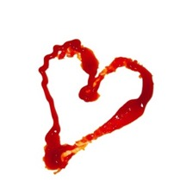
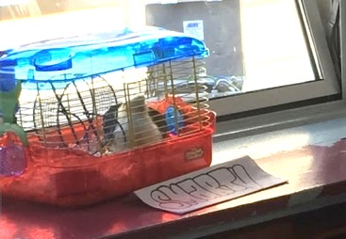
Lunch Ladies
Smarty the One Eyed Hamster RIP 3-21-17
Dahniel Knight
Special Thanks
Twin Bridges Writing Salon, Cliff Jacobson, Jeffrey Fiterman, Marina De La Rosa, Tracy Thomas & Cobalt Blue Films, Beverly Nero, Beverly Roman, Peggy & Kellan Farrell, Judy Farrell, Erez Peretz,, Pete & Annie Sokoloff, Thomas Peistrup, Bernie & Deb Walko, Joanie Midkiff, Stephanie Farrell-Lesh, Steve & Alex Bannatyne, Whitney Kershaw, Narada Meyer, Kathleen Laccinole, George Kiefer & The LA Film School, Stacy Ekstein & Market Street Productions, Cinema Makeup School, Chapman Leonard, SAG/AFTRA, Metronome Studios.

Slide 28
a
CLARISSA JACOBSON PRODUCTION

